Slide 1

SAMRAT ASHOK TECHNOLOGICAL INSTITUTE VIDISHA (M.P.)
Sepsis Predictor
Ministry/Organisation name: GE Healthcare
Problem statement: Early Prediction of Sepsis (UP49)
Team name: GENESIS
Team leader: Mukul Panchal

Slide 2
Description of Problem Statement
The goal of this Challenge is the early detection of sepsis using physiological data.
The early prediction of sepsis is potentially life-saving, and challenging participants to predict sepsis 6 hours before the clinical prediction of sepsis.
Conversely, the late prediction of sepsis is potentially life-threatening, and predicting sepsis in non-sepsis patients (or predicting sepsis very early in sepsis patients) consumes limited hospital resources.
Every hour delay treatment increase 4-8% mortality.
Detect & treat sepsis early still remains and basic question about the limits of early detection remain unanswered.

Slide 3
Idea / Approach details
A software that uses artificial intelligence to detect patient deterioration before it’s too late and trigger notifications to clinicians and care team.
Software include training of healthcare providers and front-line staff to quickly recognize symptoms to identify Sepsis and treat patients at the earliest.

Slide 4
Feasibility of project -
Our software can be used in any web browser. The device requires only an internet connection.
Simple user friendly web application.
Sustainability of project -
We are using docker system so our application can expand according to requirement. Which can run according to environment (Operating System).

Slide 5
Approach details
PATIENT
HEALTH REPORT
DATA FEEDING IN TH E WEB APP
ANALYSIS OF THE DATA (BASED ON ML ALGO)
TEST RESULT AND SUGGESTION

Slide 6
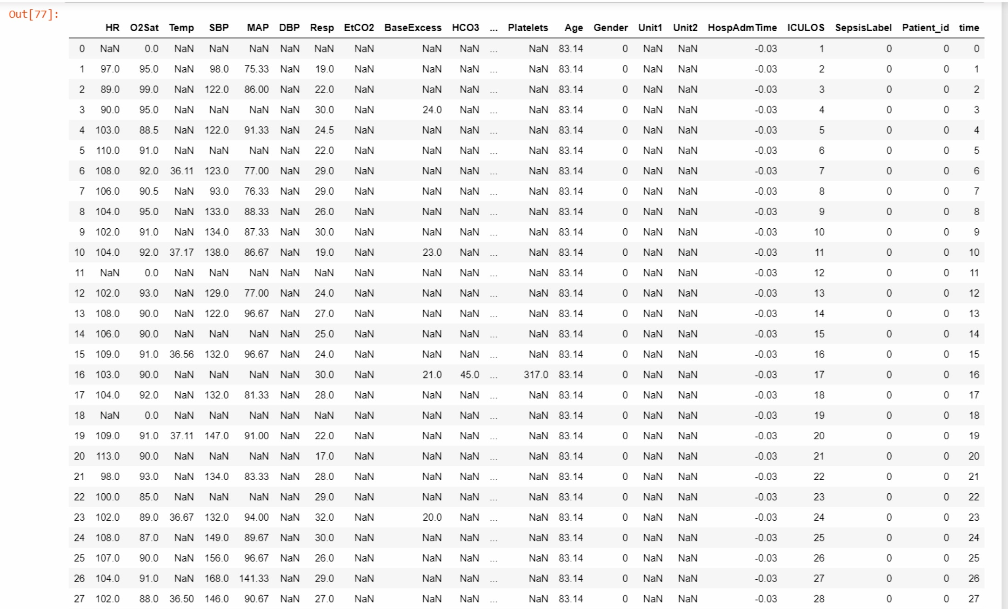
Data Set
No. of attributes = 43
Data Set- https://physionet.org/content/challenge-2019/1.0.0/

Slide 7
Attribute Details
Vital signs (columns 1-8)
HR | Heart rate (beats per minute)
O2Sat | Pulse oximetry (%)
Temp | Temperature (Deg C)
SBP | Systolic BP (mm Hg)
MAP | Mean arterial pressure (mm Hg)
DBP | Diastolic BP (mm Hg)
Resp | Respiration rate (breaths per minute)
EtCO2 | End tidal carbon dioxide (mm Hg)

Slide 8
Attribute Details
Laboratory values (columns 9-34)
BaseExcess | Measure of excess bicarbonate (mmol/L)
HCO3 | Bicarbonate (mmol/L)
FiO2 | Fraction of inspired oxygen (%)
pH | N/A
PaCO2 | Partial pressure of carbon dioxide from arterial blood (mm Hg)
SaO2 | Oxygen saturation from arterial blood (%)
AST | Aspartate transaminase (IU/L)
BUN | Blood urea nitrogen (mg/dL)
Alkalinephos | Alkaline phosphatase (IU/L)
Calcium | (mg/dL)
Chloride | (mmol/L)
Creatinine | (mg/dL)
Bilirubin_direct | Bilirubin direct (mg/dL)
Glucose | Serum glucose (mg/dL)
Lactate | Lactic acid (mg/dL)
Magnesium | (mmol/dL)
Phosphate | (mg/dL)
Potassium | (mmol/L)
Bilirubin_total | Total bilirubin (mg/dL)
TroponinI | Troponin I (ng/mL)
Hct | Hematocrit (%)
Hgb | Hemoglobin (g/dL)
PTT | partial thromboplastin time (seconds)
WBC | Leukocyte count (count*10^3/µL)
Fibrinogen | (mg/dL)
Platelets | (count*10^3/µL)
Glucose | Serum glucose (mg/dL)

Slide 9
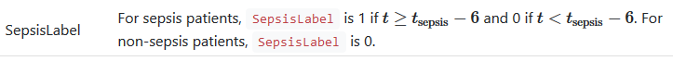
Attribute Details
Demographics (columns 35-40)
Age | Years (100 for patients 90 or above)
Gender | Female (0) or Male (1)
Unit1 | Administrative identifier for ICU unit (MICU)
Unit2 | Administrative identifier for ICU unit (SICU)
HospAdmTime | Hours between hospital admit and ICU admit
ICULOS | ICU length-of-stay (hours since ICU admit)
Demographics (columns 35-40)
Age | Years (100 for patients 90 or above)
Outcome (column 41)

Slide 10
Technologies
Docker Image
Front-End
UI-Technologies
Bootstrap
Back-End
Machine Learning
Django Frameworks
SQLite Database
JQuery
Combination of Random Forest & Gradient Boosting
Technologies

Slide 11


Prototype

Slide 12
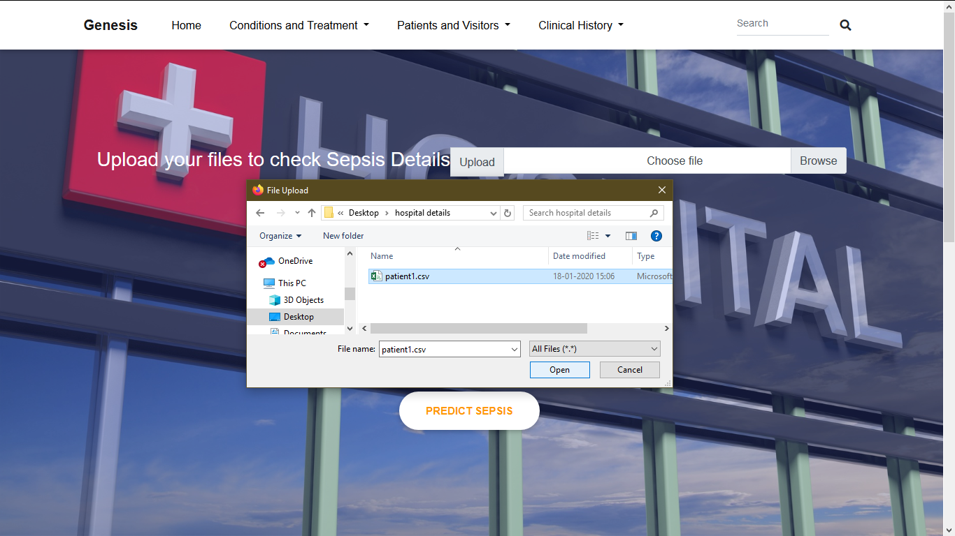
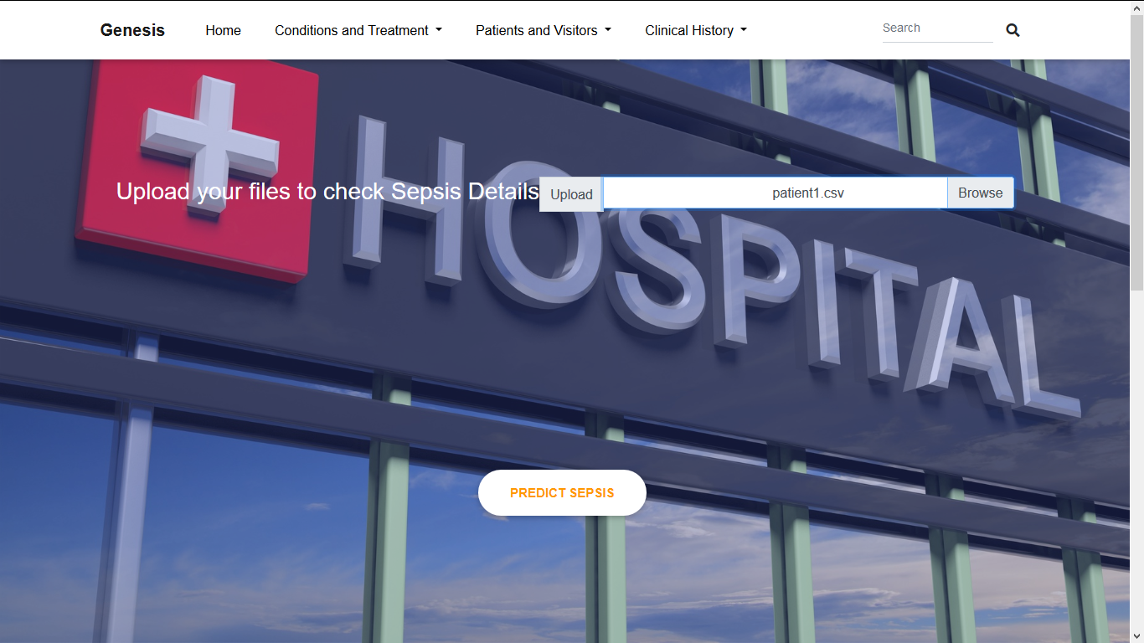
Prototype
Sepsis- 80% Predicted.
Vaccines-

Slide 13

References

Slide 14
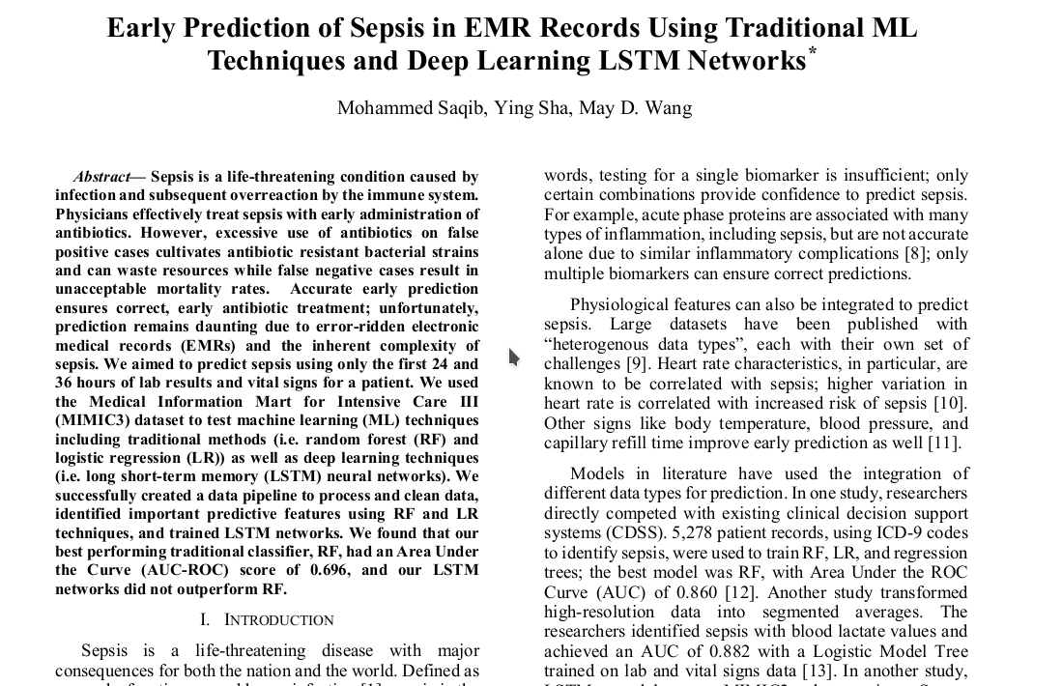
References

Slide 15
Benefits & Efficiency
It trigger notification to clinicians.
It train healthcare providers & front-line staff to treat patient .
It provide guideline & educate for earlier infection prevention.
It provide recommended vaccines.

Slide 16
According to US health care
1.7 Million developing Sepsis in U.S. in which 2.7 Lakh peoples die in every year.
World wide 30 Million people develop Sepsis in which 6 million dies and in generally 4.2 million new born & children are highly effected by this.

Slide 17
Scale of impact
According to the given abstract Sepsis costs U.S. hospitals more than any other health condition at $24 billion a year, and a majority of these costs are for sepsis patients that were not diagnosed at admission.
Sepsis costs are even greater globally with the developing world at most risk. Altogether, sepsis is a major public health issue responsible for significant morbidity, mortality, and healthcare expenses.

Slide 18
Thank You..

